Slide 1




DATATHON-2024
Code Crafters

Slide 2
”LENGTH INSIGHTS
CHALLENGE”

Slide 3
PROBLEM UNDERSTANDING
The task is to predict product lengths using both structured (e.g., category) and unstructured data (e.g., descriptions).
Accurate predictions are crucial in e-commerce for optimizing logistics, packaging, and reducing returns. The challenge involves data cleaning, feature engineering, selecting the right model, and evaluating performance using regression metrics like RMSE or MAE.
The task requires building a machine learning model that accurately estimates entity lengths, evaluated using Mean Absolute Percentage Error (MAPE).

Slide 4
EXPLORATORY DATA ANALYSIS
DATASET OVERVIEW
Features include ENTITY_DESCRIPTION (10% in other languages) and CATEGORY_ID, with ENTITY_LENGTH as the target
Word/Character Count: Calculated to explore their relationship with ENTITY_LENGTH.
TF-IDF Representation: Applied to convert descriptions into numeric features.
FEATURE EXPLORATION
TEXT ANALYSIS
TF-IDF Features and word/character count were used to predict ENTITY_LENGTH.
OUTLIER TREATMENT
Replaced outliers with category-wise median values for ENTITY_LENGTH
HANDLING MULTILINGUAL
DATA
Multilingual data (10% of the descriptions) was handled via translation.

Slide 5
PRE-PROCESSING STEPS
TEXT PREPROCESSING
Tokenized, removed special characters, and converted ENTITY_DESCRIPTION to lowercase, followed by TF-IDF vectorization.
Added word_count, char_count, and avg_word_length, and encoded CATEGORY_ID using label encoding.
FEATURE ENGINEERING
SCALING
Applied StandardScalar to numerical features (word count, character count, and encoded categories).
CATEGORICAL ENCODING
Encoded numerical values (e.g., CATEGORY_ID) into numerical format using encoding.
TRAIN-TEST SPLIT
Split the dataset into training and testing sets for model validation

Slide 6
MODEL SELECTION & PERFORMANCE ANALYSIS
Linear Regression:
Simple baseline model to establish a reference performance. While it performed reasonably, it did not capture complex relationships in the data.
Random Forest Regressor:
Chosen for its ability to model non-linear relationships. This model provided improved accuracy over Linear Regression.
Xgboost:
Integrate XGBoost for better handling of complex patterns and tree-based boosting.
Performance Metric:
MAPE was used to compare the models, and Random Forest achieved a lower MAPE, indicating better predictive accuracy.

Slide 7

PERFORMANCE ANALYSIS

Slide 8
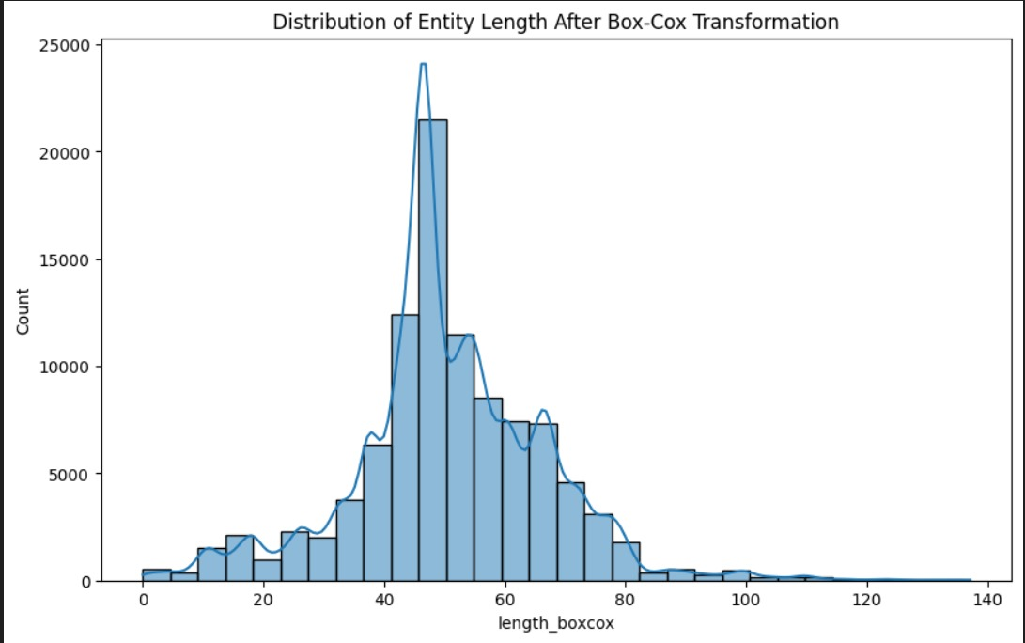

Slide 9
CHALLENGES FACED AND SOLUTIONS
Textual Feature Representation:
Challenge: Transforming raw text into a format usable by models.
Solution: Used TF-IDF vectorization to numerically represent the textual descriptions.
Model Complexity:
Challenge: Linear Regression failed to capture non-linear patterns.
Solution: Applied Random Forest, which handles complex feature interactions better.
Overfitting Risk:
Challenge: Random Forest showed a tendency to overfit.
Possible Solution: Applied cross-validation and adjusted hyperparameters to mitigate overfitting.

Slide 10
FINAL RESULTS AND RECOMMENDATIONS
Best Model: Random Forest Regressor outperformed Linear Regression with a lower MAPE score.
Key Features: Word count, TF-IDF values, and encoded metadata were the most significant contributors to the model’s predictions.
Recommendations:
Explore additional advanced text representations (e.g., embeddings) for better performance.
Experiment with hyperparameter tuning for further improvements in Random Forest.

Slide 11
FUTURE ENHANCEMENTS
Hyperparameter Tuning: Further optimize XGBoost and Random Forest with parameters like max_depth and learning_rate.
Ensemble Models: Combine predictions from multiple models for better accuracy.
Advanced Feature Engineering: Use bi-grams/tri-grams in TF-IDF and explore feature interactions.
Multilingual Support: Handle non-English descriptions with multilingual embeddings or models like BERT.
Neural Networks: Explore LSTMs or Transformers to better capture text and numerical feature relationships.

Slide 12
THANK YOU

